Slide 1

Amazon Sales Analysis Report
MOHD RAHIL

Slide 2
INTRODUCTION
In today's fiercely competitive business landscape, sales management stands as the cornerstone for commercial success and profitability. With the ever-evolving dynamics of consumer behavior and market trends, understanding sales patterns and identifying key metrics are paramount for sustainable growth. In this presentation, we embark on a journey through an Amazon dataset, leveraging the ETL (Extract-Transform-Load) process to unveil intricate sales trends on multiple dimensions.
We delve into the realm of sales management, dissecting the dataset to extract valuable insights on a month-wise, year-wise, and yearly-month-wise basis. Through rigorous analysis and visualization techniques, we uncover the pulse of sales dynamics, discerning patterns, fluctuations, and underlying factors that drive sales performance.

Slide 3
Project Details
Project Title | Analyzing Amazon Sales Data
Technologies | Data Science
Domain | E-commerce P
Tools | Jupyuter Notebooks

Slide 4
Problem Statement
Sales management has gained importance to meet increasing competition and the need for improved methods of distribution to reduce cost and to increase profits. Sales management today is the most important function in a commercial and business enterprise. Do ETL: Extract-Transform-Load some Amazon dataset and find for me Sales-trend -> month-wise, year-wise, yearly_month-wise Find key metrics and factors and show the meaningful relationships between attributes. Do your own research and come up with your findings.

Slide 5
Dataset Information
The amazon sales data contain the information like such as Region Country, Item Type, Sales Channel, Order Priority, Order Date, Order ID, Ship Date, Units Sold, Unit Price, Unit Cost, Total Revenue, Total Cos and Total Profit etc.

Slide 6
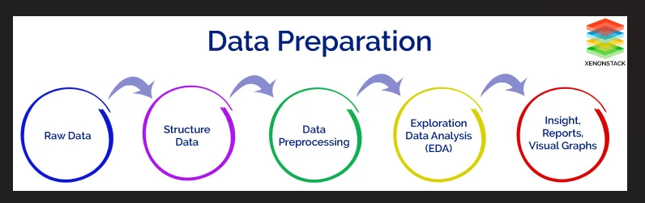
Data Process

Slide 7
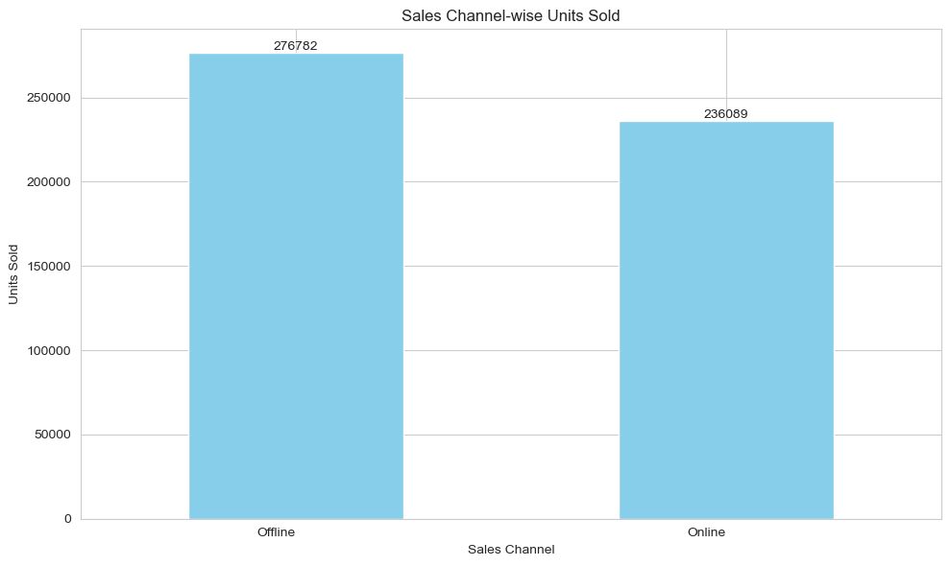
Channel Wise Sales
Offline Product Sales Total Quantity 276782 or revenue will generate More and Online Product sales Total Qty is 236089 or revenue will generate less as compared to Offline . As we can analyze that customer trust is more in Offline mode as compare to online so we need to focus on Online Channel

Slide 8
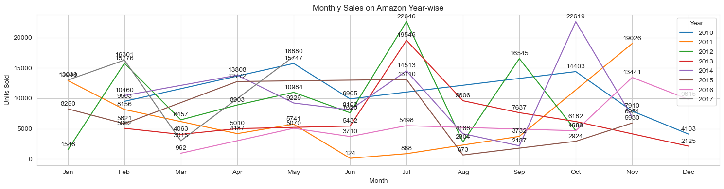
Monthly Sales Analysis
Monthly Sales analysis from year 2010-17
We analyze that all time Highest sales occur in the Month Of July

Slide 9
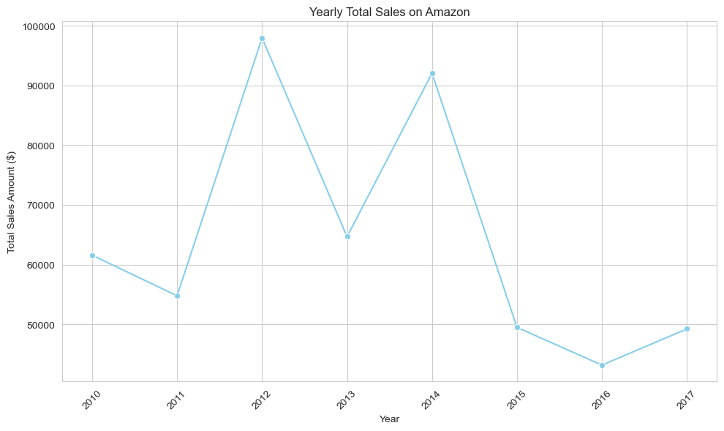
Yearly Sales Trend
In 2012 is sales is Highest at 98k and Revenue will generate at 31.9M , 2016 is lowest sales at 43k and Revenue will generate at 12.37M

Slide 10
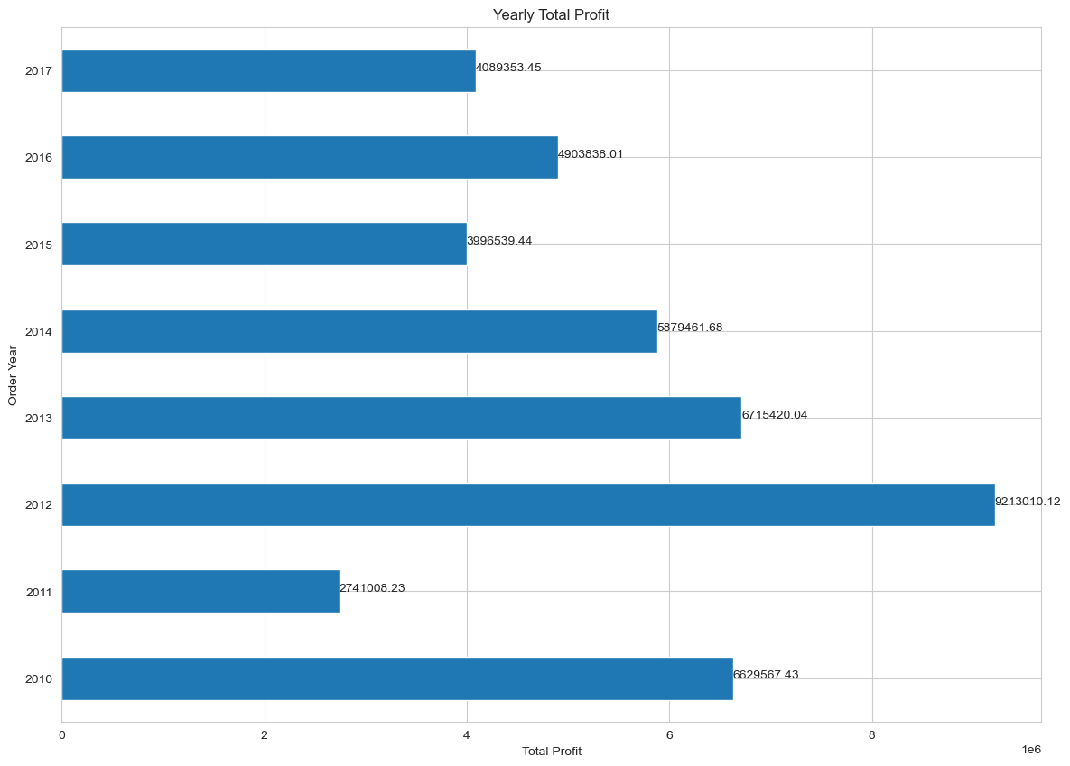
Profit By Year
2012 is the Most Profitable Year at 9.2M

Slide 11
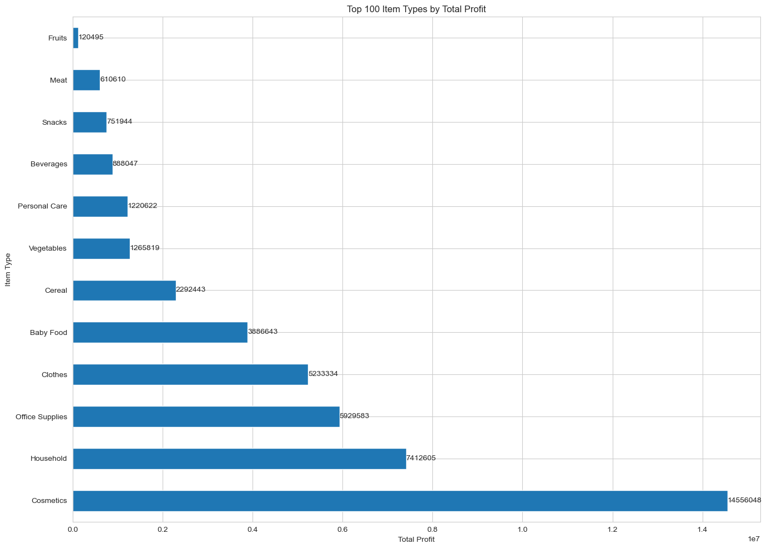
Most Profitable Product
Cosmetic is the all time Most Profitable product at 14.6M.

Slide 12
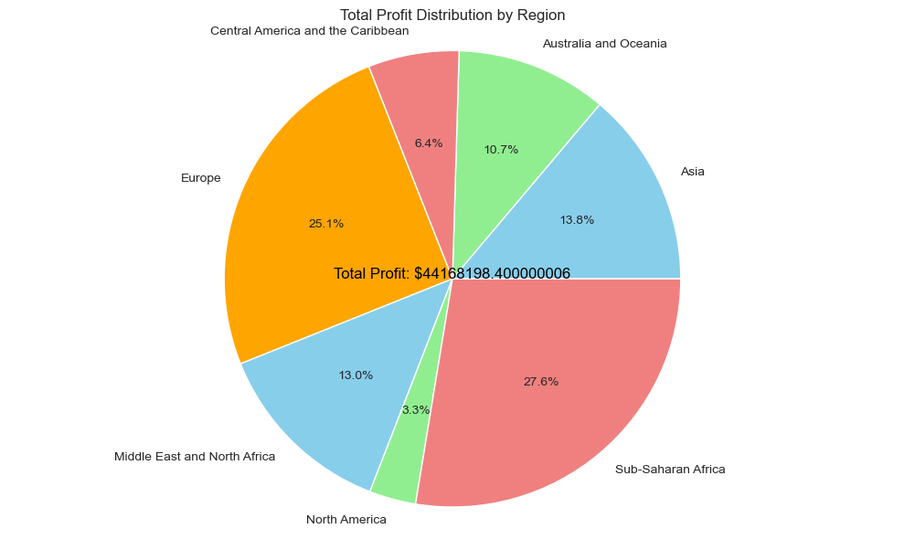
Region Wise Profit
Sub-Saharan Africa region was the Most Profitable region with contribution of 27.6%

Slide 13
Conclusion
Offline channel generate more sales 276782 comparison to online channel sales 236089.
If we observe the monthly insights of 2010 to 2017 the sales are at their peak in February , May, Nov, Oct and July and are low in March ,August, &December.
In 2012 the sales is at Highest Peak in context of other years and 2012 was the Most Profitable Year at 9.2M.
4. The Cosmetic is Most Profitable Product and Fruit is Least Profitable product in markets.
Sub- Saharan is the Most Profitable Region in context of others.

